Slide 1
Module 3: Cloud Computing Deployment Models

Slide 2
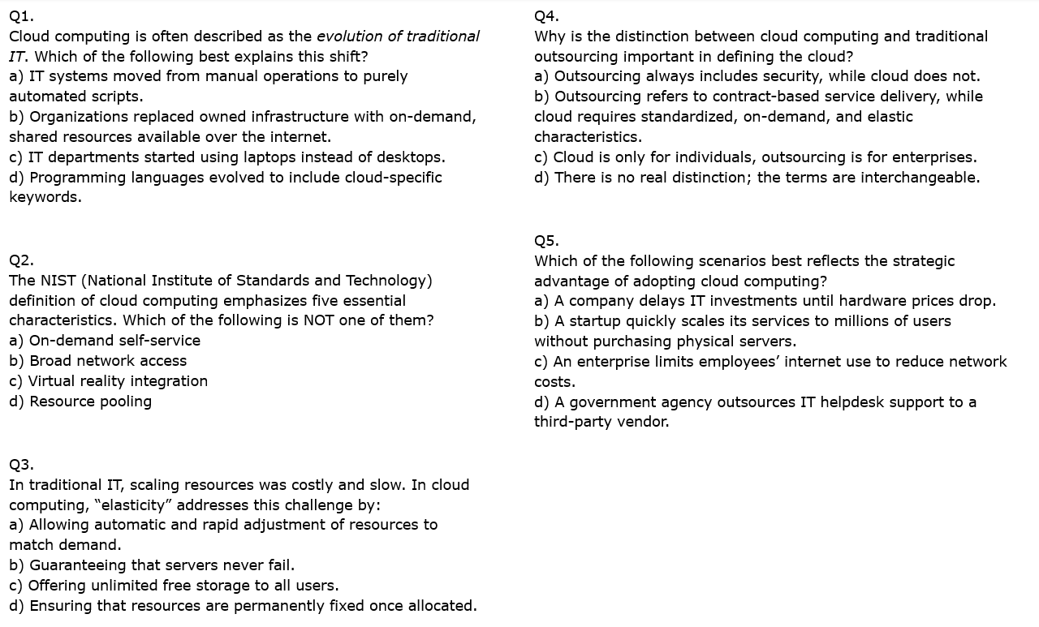
Quiz for revising on previous work
Notes:
Q1.
Cloud computing is often described as the evolution of traditional IT. Which of the following best explains this shift?
Correct Answer: b) Organizations replaced owned infrastructure with on-demand, shared resources available over the internet.
This reflects the fundamental change: moving from capital-intensive, owned IT to cloud-based, service-oriented IT.
Why others are incorrect:
a) IT systems moved from manual operations to purely automated scripts → Automation is important, but it predates cloud. This does not capture the essence of cloud adoption.
c) IT departments started using laptops instead of desktops → Hardware choices are unrelated to the definition of cloud computing.
d) Programming languages evolved to include cloud-specific keywords → Language changes are incidental, not the defining shift.
Q2.
The NIST (National Institute of Standards and Technology) definition of cloud computing emphasizes five essential characteristics. Which of the following is NOT one of them?
Correct Answer: c) Virtual reality integration
VR is a separate technology domain, not a NIST-defined cloud characteristic.
Why others are incorrect:
a) On-demand self-service → A core NIST characteristic (users can provision services without provider intervention).
b) Broad network access → Also a NIST characteristic (services available over the internet or network).
d) Resource pooling → Another NIST characteristic (multi-tenancy, resources shared dynamically).
Q3.
In traditional IT, scaling resources was costly and slow. In cloud computing, “elasticity” addresses this challenge by:
Correct Answer: a) Allowing automatic and rapid adjustment of resources to match demand.
Elasticity means resources can grow or shrink automatically with workload changes.
Why others are incorrect:
b) Guaranteeing that servers never fail → High availability is important but not elasticity.
c) Offering unlimited free storage to all users → Storage is scalable, but not unlimited or free.
d) Ensuring that resources are permanently fixed once allocated → This is the opposite of elasticity.
Q4.
Why is the distinction between cloud computing and traditional outsourcing important in defining the cloud?
Correct Answer: b) Outsourcing refers to contract-based service delivery, while cloud requires standardized, on-demand, and elastic characteristics.
Cloud is defined by specific characteristics, not just external service delivery.
Why others are incorrect:
a) Outsourcing always includes security, while cloud does not → Both may include security, so this is misleading.
c) Cloud is only for individuals, outsourcing is for enterprises → False; both models can serve any type of customer.
d) There is no real distinction; the terms are interchangeable → Incorrect; cloud has formal definitions and unique characteristics.
Q5.
Which of the following scenarios best reflects the strategic advantage of adopting cloud computing?
Correct Answer: b) A startup quickly scales its services to millions of users without purchasing physical servers.
This demonstrates agility, scalability, and the key business benefit of cloud.
Why others are incorrect:
a) A company delays IT investments until hardware prices drop → This is cost control, not a cloud-enabled strategy.
c) An enterprise limits employees’ internet use to reduce network costs → Irrelevant to cloud benefits.
d) A government agency outsources IT helpdesk support to a third-party vendor → Outsourcing is not the same as cloud computing.

Slide 3
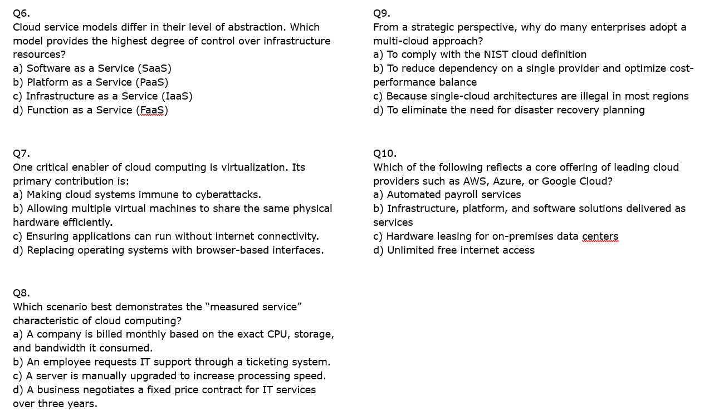
Continued . . . .
Notes:
Q6.
Cloud service models differ in their level of abstraction. Which model provides the highest degree of control over infrastructure resources?
Correct Answer: c) Infrastructure as a Service (IaaS)
IaaS provides direct access to virtualized servers, storage, and networking.
Why others are incorrect:
a) SaaS → Least control (vendor manages application, platform, and infrastructure).
b) PaaS → Developers control apps but not the underlying infrastructure.
d) FaaS → Even more abstract, where only functions are deployed.
Q7.
One critical enabler of cloud computing is virtualization. Its primary contribution is:
Correct Answer: b) Allowing multiple virtual machines to share the same physical hardware efficiently.
Virtualization maximizes hardware utilization and enables multi-tenancy.
Why others are incorrect:
a) Making cloud systems immune to cyberattacks → Virtualization doesn’t guarantee immunity.
c) Ensuring applications can run without internet connectivity → Connectivity is usually essential.
d) Replacing operating systems with browser-based interfaces → OSs still exist in virtual machines; browsers are just clients.
Q8.
Which scenario best demonstrates the “measured service” characteristic of cloud computing?
Correct Answer: a) A company is billed monthly based on the exact CPU, storage, and bandwidth it consumed.
Measured service means resources are tracked and billed based on usage.
Why others are incorrect:
b) An employee requests IT support through a ticketing system → This is helpdesk, not measured service.
c) A server is manually upgraded → That’s hardware management, not usage-based billing.
d) A fixed price contract → Opposite of usage-based billing.
Q9.
From a strategic perspective, why do many enterprises adopt a multi-cloud approach?
Correct Answer: b) To reduce dependency on a single provider and optimize cost-performance balance.
Multi-cloud strategy prevents vendor lock-in and increases resilience.
Why others are incorrect:
a) To comply with the NIST cloud definition → NIST doesn’t mandate multi-cloud.
c) Because single-cloud architectures are illegal → No such legal restriction.
d) To eliminate the need for disaster recovery → DR planning is still essential.
Q10.
Which of the following reflects a core offering of leading cloud providers such as AWS, Azure, or Google Cloud?
Correct Answer: b) Infrastructure, platform, and software solutions delivered as services.
These are the three foundational models: IaaS, PaaS, SaaS.
Why others are incorrect:
a) Automated payroll services → This is an application, not a cloud service model.
c) Hardware leasing for on-premises data centers → Cloud avoids physical ownership.
d) Unlimited free internet access → Internet is required but not provided as a free service.

Slide 4
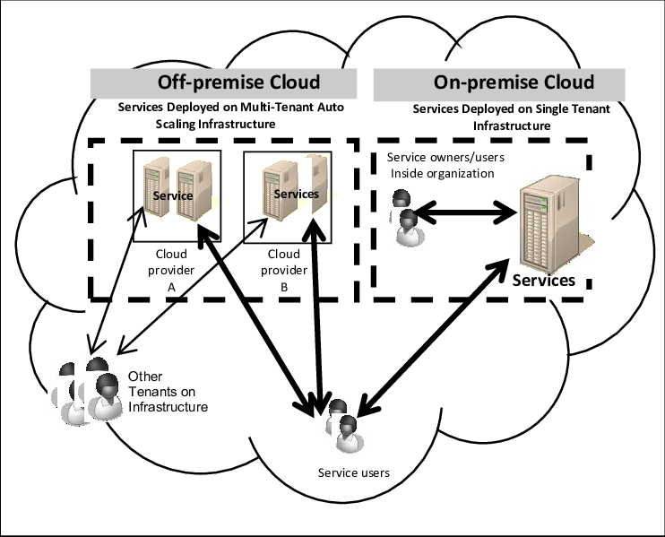
off-premises versus on-premises cloud computing
https://www.researchgate.net/figure/SoA-deployed-on-off-premises-versus-on-premises-cloud-computing_fig1_262374267

Slide 5
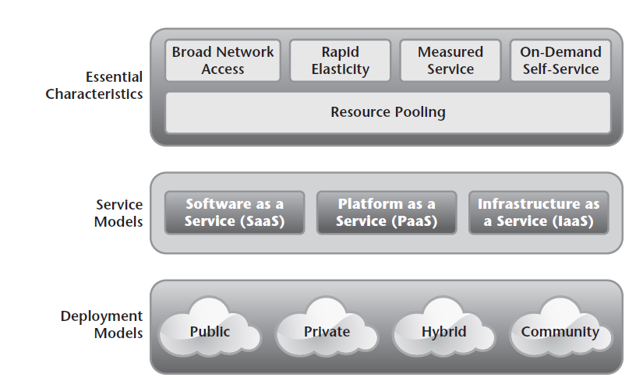
Deployment Models
Following Fig. shows the NIST visual model of cloud computing.

Slide 6
Public cloud
A public cloud is a multitenant environment where the end user pays for usage of resources on a shared grid of commodity resources alongside other customers.
The end users have no visibility into the physical location of where their software is running other than where the data centre is located.

Slide 7
Public cloud
Gmail, Google Drive are examples of public cloud services. Here we are listing various services provided by public cloud companies in the market:
Microsoft Azure ExpressRoute
Google Cloud Interconnect
AWS Direct Connect
Blue cloud by IBM
Alibaba Cloud
Oracle Cloud FastConnect

Slide 8
Benefits of Public Cloud
Availability
Scalability
Accessibility.
Cost Savings

Slide 9
Drawbacks of Public Cloud
Integration Limitations:
Reduced Flexibility
Forced Downtime

Slide 10
Responsibilities of Public Cloud
In a public cloud, the service provider is responsible for all the components needed to implement the service.
The customer is responsible for installing the client-side application and ensuring that it is functioning properly.
The customer is responsible for general client maintenance.
The customer is also responsible for providing network connectivity to the provider.

Slide 11
Security Considerations
Ensuring security is especially difficult in public cloud scenarios.
Data
There is also an issue with data access. Theoretically, anyone who works at the service provider could potentially have access to your data.
Compliance
Auditing

Slide 12
Private cloud
The cloud infrastructure is provisioned for exclusive use by a single organization comprising multiple consumers (e.g., business units).
The advantage of a private cloud is that it addresses the disadvantages of the public cloud defined earlier
Private cloud end users deploy on a single-tenant environment and are not combined with other customers.

Slide 13
Benefits of Private cloud
Support and Troubleshooting
Maintenance
Monitoring

Slide 14
Drawbacks of Private cloud
Cost
Hardware and Software Compatibility
Expertise Needed

Slide 15
Responsibilities of Private cloud
In a private cloud environment, the division of responsibilities is pretty straightforward. Your organization will be responsible for the end-to-end solution. You are responsible for the systems that provide the service, the client applications, and the maintenance of the client systems.

Slide 16
Security Considerations of Private cloud
Ensuring security is easier in a private cloud environment.
In a private cloud environment, you will be able perform your security and compliance audits.
Data
Auditing

Slide 17
Example of Private cloud
The Cisco Quickstart Private Cloud, which is a self-service private cloud environment
Dell has a wide range of cloud solutions (hybrid and private) powered by Intel architecture.
Like Amazon, public cloud giant Google also offers a virtual private cloud (VPC)
Hewlett Packard Enterprise (HPE) offers an end-to-end private cloud solution portfolio, starting from data centers and infrastructure as a service (IaaS) to consumption services and private cloud consulting.

Slide 18
Hybrid cloud
Hybrid cloud is the combination of compute or storage products from public cloud services (such as Amazon Web Services, Google Cloud Platform, or Microsoft Azure) with a private cloud infrastructure–servers that are generally on-premises running a cloud software stack.

Slide 19
Hybrid cloud
A composition of two or more distinct cloud infrastructures (private, community, or public) that remain unique entities, but are bound together by standardized or proprietary technology that enables data and application portability (e.g., cloud bursting for load balancing between clouds).
A best practice for hybrid clouds is to use the public cloud as much as possible to get all the benefits of cloud computing like rapid elasticity and resource pooling, but leverage the private cloud where the risks in areas of data ownership and privacy are too high for the public cloud.

Slide 20
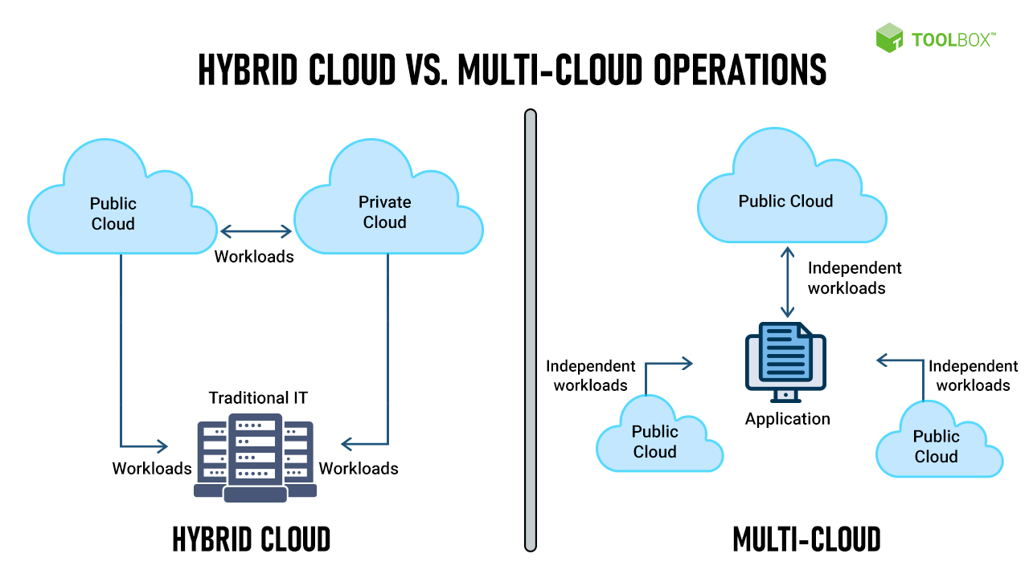
https://www.toolbox.com/tech/cloud/articles/multi-cloud-vs-hybrid-cloud/

Slide 21
Why does hybrid cloud matter?
Hybrid cloud provides the best of both worlds of computing.
The Public cloud service providers offer different ability
Having a private cloud component provides peace of mind.
Hybrid cloud solutions: IBM, Amazon, Microsoft, AWS Outposts, Azure Stack, Fujitsu Hybrid Cloud Services

Slide 22
Hybrid cloud benefits
Flexibility
Security
Certain applications hosted in two environments. That way, if one environment goes down, you can still access the application

Slide 23
Hybrid cloud Drawbacks
Integration
Security Considerations
Data
Auditing

Slide 24
COMMUNITY CLOUDS
Community clouds aren’t used as much as public or private clouds; in fact, they are the least known and least used cloud deployment model. In a community cloud, the cloud is shared by a group of organizations that have a common purpose or goal.
Benefits:
Cost
Multitenancy

Slide 25
COMMUNITY CLOUDS Drawbacks
Ownership: Ownership in a community cloud needs to be clearly defined. If multiple organizations are coming together to assemble infrastructure, you must determine some agreement for joint ownership.

Slide 26
Cloud Computing Architecture: Roles
End User will consume Cloud service without knowing it’s provided by a cloud computing platform. For example, Gmail users.
Cloud Consumer will purchase cloud services to operate their applications. E.g., we can host our website in EC2.
Cloud broker will provide brokering service for cloud computing services, similar to priceline.com for brokering flights, hotels, and car rentals.
Cloud auditor will ensure the cloud is running in a good manner, for example, the federal IT security agency.
Cloud provider is the company that provide cloud computing as a service and charge to the service, such as Amazon.
Cloud carrier is the network operator that help carry cloud service to users.

Slide 27
In class activity : Cloud type
Case Scenario | Cloud Type
A startup hosts its mobile application and databases on AWS to ensure scalability and availability.
A multinational bank operates its core banking system on an in-house data center but uses Microsoft Azure for customer service chatbots.
A government agency maintains an internal cloud for confidential citizen records.
A university uses Google Cloud to host its student learning platform and online courses.
A network of hospitals collaborates on a shared cloud to securely exchange patient health records and treatment research.
A logistics company uses IBM Cloud to analyze shipment data and optimize delivery routes.
A global retail chain runs its customer loyalty program on a private cloud but integrates with a public cloud for AI-based recommendations.
A law enforcement network shares a cloud infrastructure to store case files and forensic data across different agencies.
A small business stores its files on Dropbox and Google Drive for easy access and collaboration.
A pharmaceutical company maintains a private cloud for drug research data but uses AWS for marketing and outreach.
Several regional banks collaborate on a shared cloud platform to monitor fraud patterns and ensure regulatory compliance.
A city’s smart infrastructure runs its IoT-based traffic monitoring system on a government-managed cloud.
A gaming company deploys multiplayer game servers on Microsoft Azure, allowing global access to players.
A university research consortium develops an AI-based climate modeling system using a shared cloud infrastructure.
A national airline uses a private cloud to store passenger details but utilizes a public cloud for flight booking and customer engagement.
A multinational media company creates a shared cloud with partners to store and distribute high-resolution video content.
A university allows students to run machine learning models using a mix of on-campus cloud infrastructure and Google Cloud.
A defense organization develops classified applications on an in-house, restricted-access cloud.
A group of non-profit organizations working on environmental research shares a cloud to analyze climate data.

Slide 28
Learning Activity 1:
Do your research on the internet and find a real-life case study for one of the deployment models discussed in this module (public, private, hybrid or community). Write about the case study in your own words in the discussion forum and include details about the scenario, current and future requirements, and why the chosen model is the best option for the company in no more than 300 words.
As part of the exercise, you may want to consider drawing a mind map outlining the various considerations the company may have had to make when migrating to the cloud. You could do this as a hand-drawn image or take a photo then upload it to the discussion forum or draw it in an application like PowerPoint.

Slide 29
Case Study: Airbnb's Migration to Public Cloud
In its early stages, Airbnb faced challenges with its initial cloud service provider, particularly concerning service administration and scalability. To address these issues, Airbnb decided to migrate nearly all of its cloud computing functions to Amazon Web Services (AWS). This move allowed Airbnb to efficiently manage and customize its infrastructure, enabling rapid scaling to meet the demands of its growing user base. The flexibility and extensive services offered by AWS provided Airbnb with the necessary tools to enhance performance and support its expanding operations.
Amazon Web Services
Scenario: Airbnb, a platform connecting hosts with travelers, experienced rapid growth, necessitating a robust and scalable infrastructure. The company required a solution that could handle fluctuating workloads, ensure high availability, and support global expansion.
Current and Future Requirements:
Scalability: Ability to accommodate increasing user traffic and data storage needs.
Reliability: Ensure consistent uptime and quick recovery from potential failures.
Global Reach: Support services in multiple regions worldwide.
Cost Efficiency: Optimize operational costs while maintaining performance.
Why Public Cloud (AWS) Was the Best Option: Migrating to AWS's public cloud offered Airbnb several advantages:
Elasticity: AWS's infrastructure allowed Airbnb to scale resources up or down based on demand, ensuring efficient use of resources.
Comprehensive Services: Access to a wide range of services, including computing power, storage solutions, and databases, facilitated rapid development and deployment of new features.
Global Infrastructure: AWS's worldwide data centers enabled Airbnb to provide low-latency experiences to users across the globe.
Cost Management: The pay-as-you-go pricing model helped Airbnb manage costs effectively, aligning expenses with actual usage.

Slide 30
Learning Activity 2:
There are various business challenges associated with Cloud deployments. ‘Higher costs’ are regarded as one of them. Read the following white paper titled ‘IT@Intel Brief, A Holistic Cloud Approach for Big Savings’ and answer the following questions: What are the business challenges associated with higher cloud costs? What are the strategies adopted by the vendor to reduce costs? Briefly discuss one of the cost reduction strategies that you think can be applicable if you wish to deploy a service in the cloud. Post your answer to the Module 3 discussion forum.

Slide 31
Business Challenges Associated with Higher Cloud Costs:
Slower Time-to-Market (TTM): Without a standard approach to cloud solutions, business groups often face delays and inefficiencies in implementing cloud services, resulting in slower project execution.
Inefficient Management: The use of disparate cloud accounts leads to inconsistent technology stacks and a lack of integration. This hampers optimization and alignment of workloads for maximum performance.
Higher Costs: Different departments or business units using separate cloud accounts prevents cost consolidation. This makes it difficult to negotiate better pricing, leading to missed opportunities for savings.
Strategies Adopted to Reduce Cloud Costs:
Centralized Management: Intel centralized its cloud accounts and workloads, enabling them to optimize resources and negotiate better discounts with cloud providers.
Reserved Instances (RIs): By reserving cloud capacity for one or three years, Intel achieved significant savings (around 30-35%) compared to on-demand pricing.
Run-rate Discounts: Combining workloads across the enterprise helped Intel understand their cloud spending and qualify for larger discounts from cloud providers.
Spot Instances with Artificial Intelligence (AI): Intel uses AI to predict the loss of spot instances ahead of time, allowing them to reallocate workloads to other resources. This approach saved Intel 75-80% over on-demand costs.
Applicable Cost Reduction Strategy for Cloud Deployment:
One strategy that can be particularly applicable when deploying a service in the cloud is using Reserved Instances (RIs). This approach allows you to reserve cloud resources for a fixed period (one or three years) at a significantly lower cost than on-demand pricing. For businesses with predictable workloads or services that do not need frequent scaling, RIs offer substantial savings while ensuring resource availability. By committing to reserved resources, you can avoid fluctuating hourly rates and plan your infrastructure costs in a more stable and predictable manner, ultimately improving cost efficiency.
This approach would be valuable for organizations looking to streamline their cloud spend while ensuring that their critical services and applications remain available without unexpected cost spikes.

